Slide 1

Analyzing Lending Finances Group – 5
Kashish Sunil Shah (200545460) Abdirahman Ahmed Ali (200579531) Shishir Aryal (200582212)
Praveen Chaudhary (200581245)

Slide 2
Project Summary
This project involves acquiring, analyzing, and storing loan data using Python and SQLite. Initially, loan data is acquired from a CSV file and analyzed to identify trends and patterns. A SQLite database named 'loans.db' is created, and a table schema is defined to store the loan data. The data is inserted into the database table, ensuring data integrity. A pseudo-batch process is implemented using the Schedule library to automate data acquisition and storage every 24 hours, ensuring the database remains up-to-date. This project enables efficient management and analysis of loan data, providing valuable insights for Horizon Bank's loan management strategies, with potential future enhancements including advanced analytics and machine learning integration for predictive modeling.

Slide 3



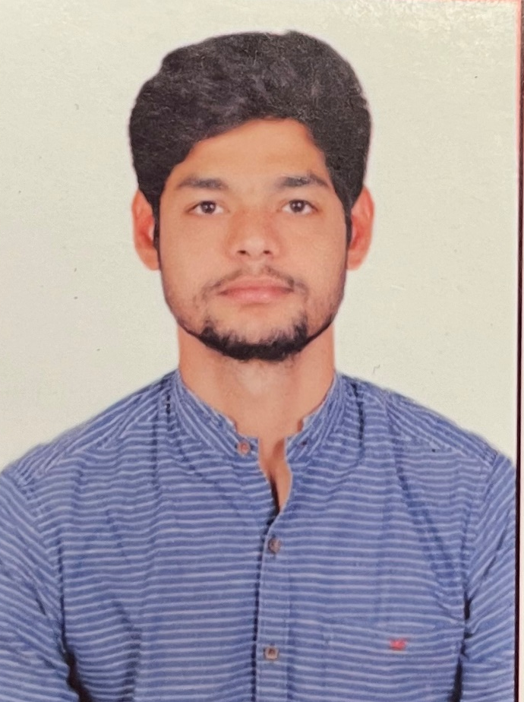
Team Profiles
Kashish Sunil Shah
(Project Manager and Developer)
PGDM in Artificial Intelligence
B.Sc. In Mathematics (Honors)
Abdirahman Ahmed Ali
(Data Analyst)
PGDM in Big Data Analytics
Bsc. In Computer Science
Shishir Aryal
(Business Analyst)
PGDM in Big Data Analytics
B.Sc.. In Statistics
Praveen Chaudhary
(Financial Analyst)
PGDM in Data Analytics
Bachelor in Computer Application

Slide 4
Project Description
Acquisition
Acquisition and Storage: Utilize Python's pandas library to acquire loan data from a CSV file. Establish a SQLite database named 'loans.db' for storage.
Define
Database Schema Definition: Define a table schema within the SQLite database to organize the loan data, ensuring consistency and integrity.
Insert
Data Insertion: Insert the acquired loan data into the designated table within the SQLite database, facilitating efficient data management.
Implement
Scheduled Automation: Implement a scheduled job using the Schedule library to automate the process of data acquisition and storage. Ensure regular updates every 24 hours to keep the loan data up-to-date.
Enable
Analysis and Insights: Enable Horizon Bank to conduct thorough analysis of loan data.

Slide 5

The application's home page is a dashboard where users can enter the ticker symbol and date range to retrieve the loan data.
If the requested data is not in the database, the application fetches it from the Kaggle (https://www.kaggle.com/datasets/sahilnbajaj/loans-data), inserts it into the database, and then displays it on the dashboard.
The application runs on a local server, and the user interface is built using HTML templates. The background thread that updates the database runs on a separate thread to ensure that the user interface remains responsive

Slide 6

Demonstration through Google Collab (locally)

Slide 7
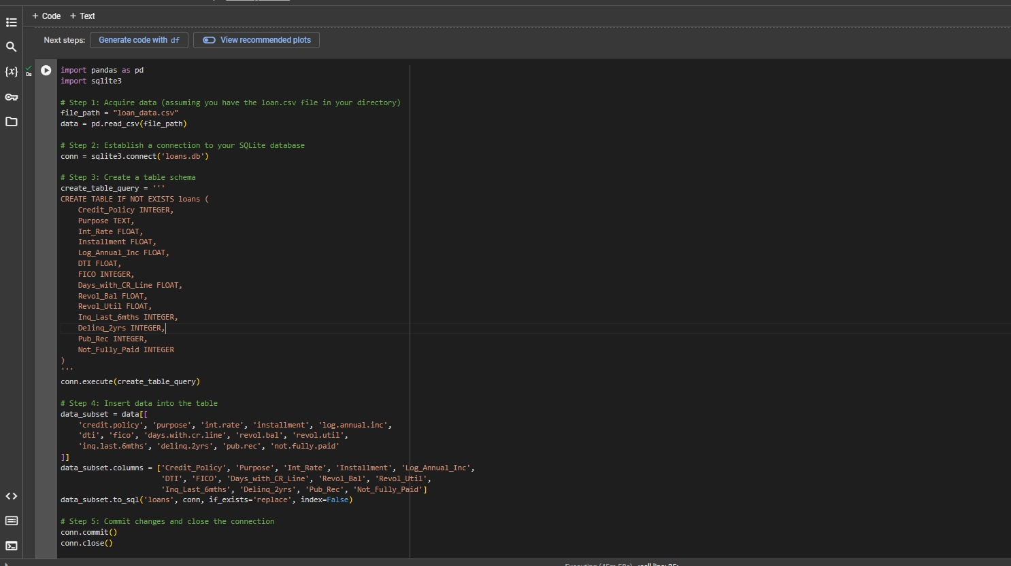
Database Creation

Slide 8
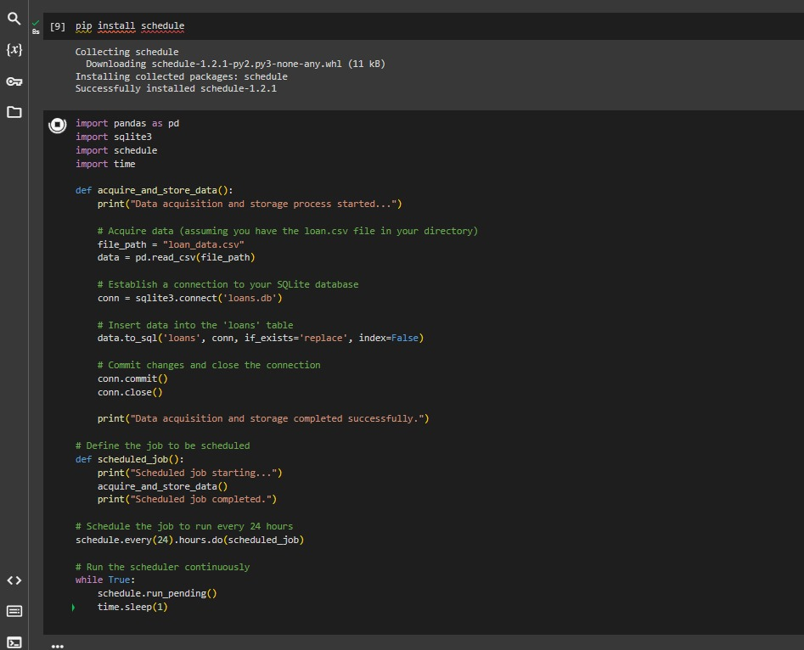
Pseudo Batch Process (24Hrs)

Slide 9
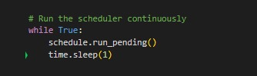
Pseudo Batch Process (contd…)

Slide 10
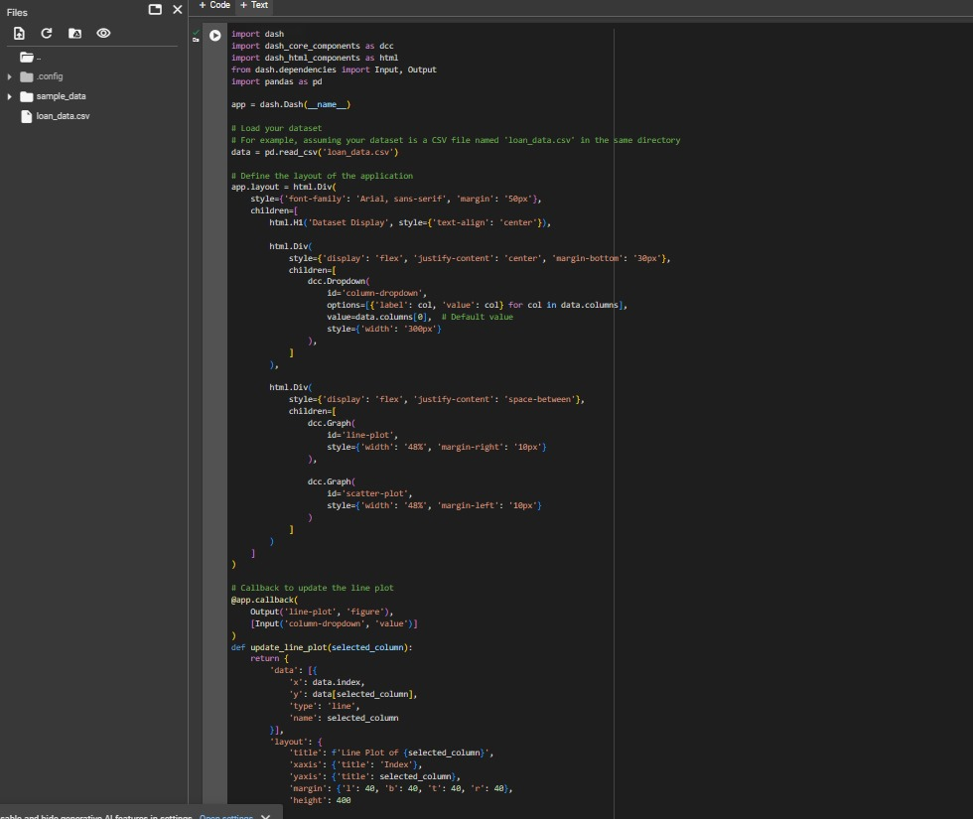
Codes to Generate Graph

Slide 11

Application Running on Local Host

Slide 12
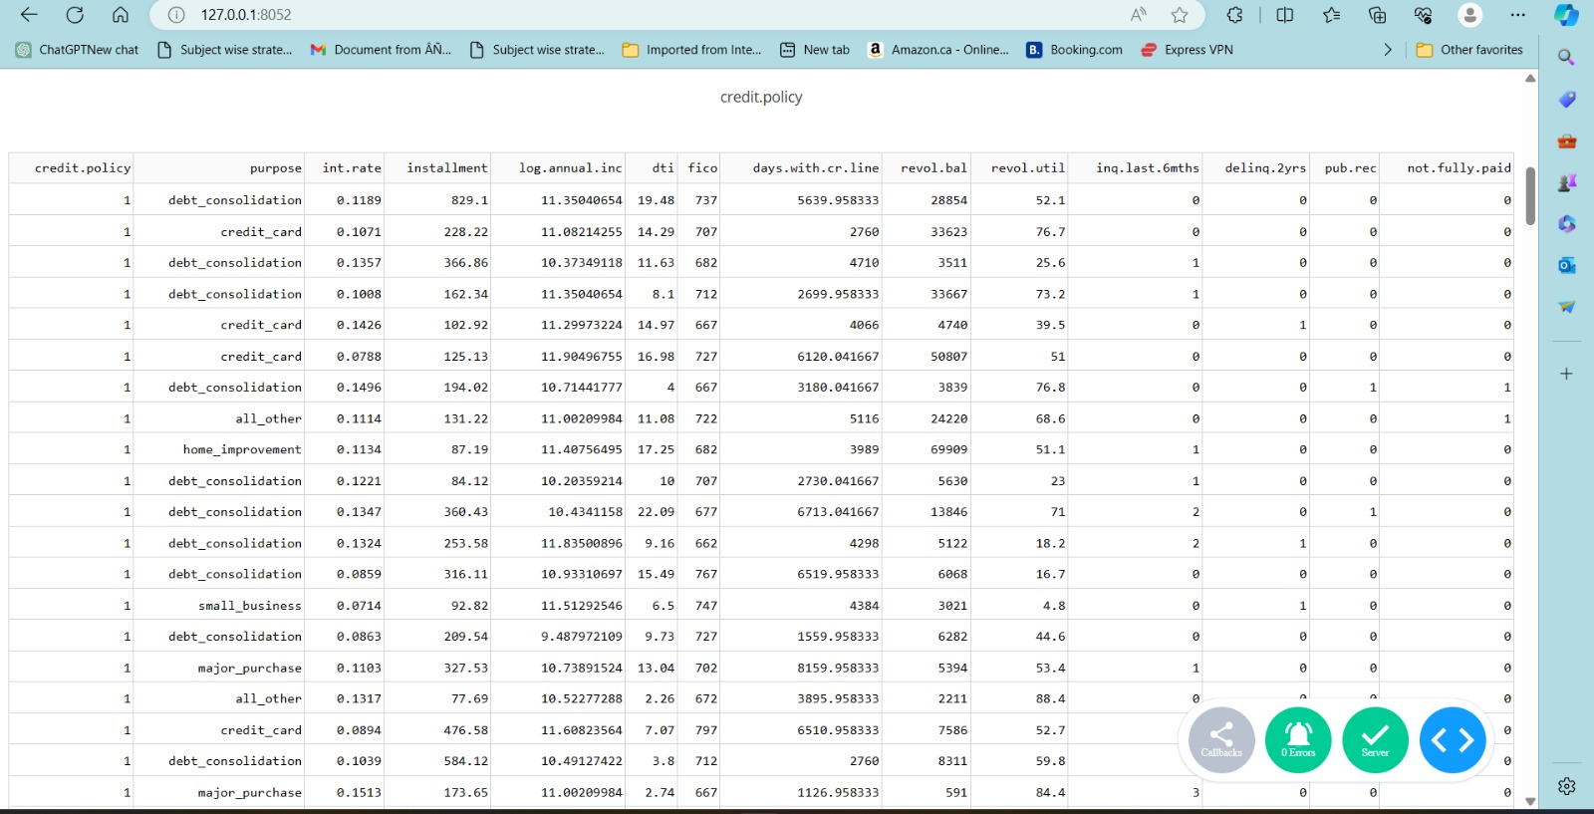
Displaying Dataset using Localhost (port 8052)

Slide 13
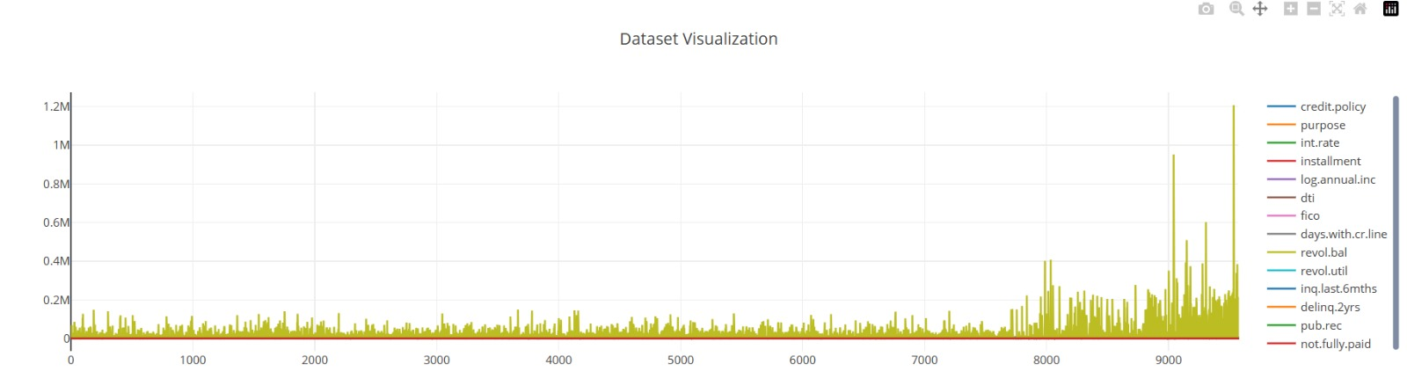
Data Visualization using localhost (port 8050)

Slide 14
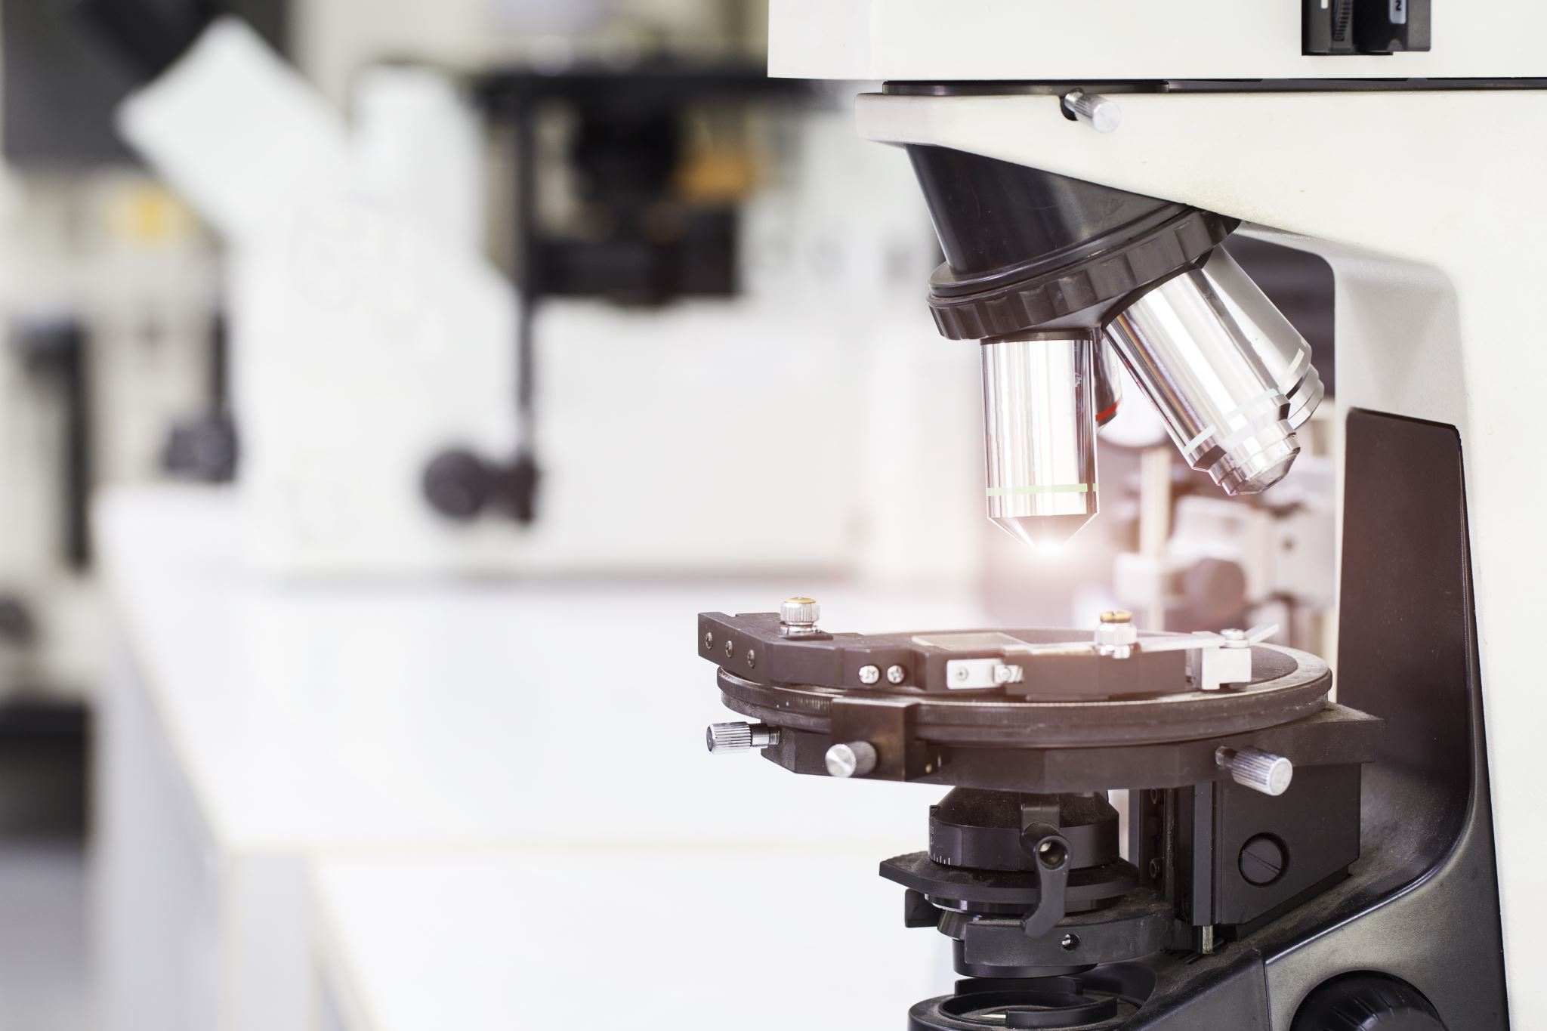
SWOT ANALYSIS

Slide 15


Thank you

